Slide 1


SPRING VALLEY VILLAGE POLICE DEPARTMENT
MONTHLY NEWSLETTER:
AUGUST 2026
1025 CAMPBELL ROAD
HOUSTON, TX 77055
PHONE: 713-465-8323
COMMUNITY MATTERS.
WE ARE A TEAM.

Slide 2

INTRODUCTION
Hilshire Village Residents,
We wanted to wish all the students a great 2026-2027 school year. Spring Valley Village Police Department wants you to have fun while staying safe. Please be vigilant and observant of your surroundings, wherever you are. Remember: See Something, Say Something.
KEEP IN MIND:
  Be sure to lock all doors and windows in your home, when you are not on the premises.
  Lock your vehicle when it is unoccupied. Remove all valuables.
As always we are here if you need us!
Sincerely,
Chief M. Schulze
1025 CAMPBELL ROAD, HOUSTON, TX 77055
PHONE: 713-465-8323 / EMAIL: DISPATCH@SPRINGVALLEYTX.COM

Slide 3

AUGUST 2026
DATE | DAY | SPECIAL DAYS FOR THIS MONTH
08-13-2026 | THURSDAY | FIRST DAY OF SCHOOL
COMMUNITY MATTERS.
WE ARE A TEAM.
Helpful Links to Spring Branch Independent School District:
SBISD Website: https://www.springbranchisd.com/
SBISD Link to Printable Academic Calendar for 2026-2027:
www. https://www.springbranchisd.com/about/calendars
1025 CAMPBELL ROAD, HOUSTON, TX 77055 / PHONE: 713-465-8323 / EMAIL: DISPATCH@SPRINGVALLEYTX.COM

Slide 4

KEEP IN MIND:
COMMUNITY MATTERS.
WE ARE A TEAM.
1025 CAMPBELL ROAD, HOUSTON, TX 77055 / PHONE: 713-465-8323 / EMAIL: DISPATCH@SPRINGVALLEYTX.COM

Slide 5
Back to School Safety Tips:
Safe travel to school
  Walking: Cross streets at intersections or crosswalks, making eye contact with drivers before crossing, and avoid distractions like phones or headphones.
  Biking: Ride on the right side of the road in single file, stop at intersections, and always wear a properly fitted helmet and bright clothing.
  Car Travel: Ensure children use seat belts, car seats, or booster seats appropriate for their age and size, and ride in the back seat until at least 13 years old
  Sgt. T. Wood
Personal Safety
  Buddy System: Encourage children to walk or bike with friends to increase safety
  Emergency Knowledge: Make sure children know their phone number, address, how to contact parents or another trusted adult, and how to dial 911.
  Backpacks: Ensure backpacks are not overloaded to prevent strain or injury.
Officer A. Rendon
COMMUNITY MATTERS.
WE ARE A TEAM.
1025 CAMPBELL ROAD, HOUSTON, TX 77055 / PHONE: 713-465-8323 / EMAIL: DISPATCH@SPRINGVALLEYTX.COM

Slide 6
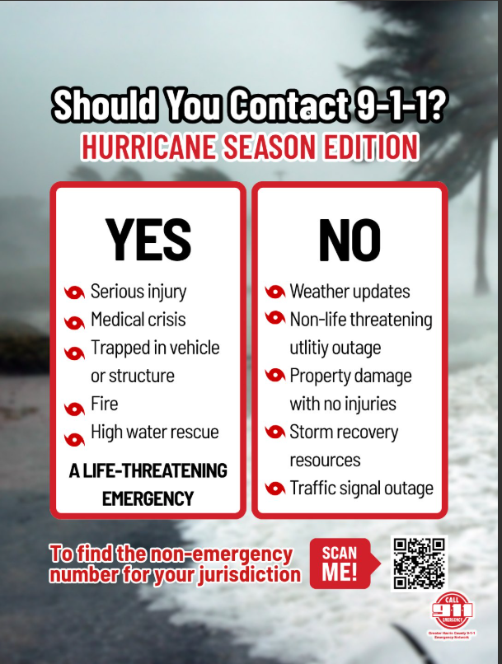
1025 CAMPBELL ROAD, HOUSTON, TX 77055
PHONE: 713-465-8323 / EMAIL: DISPATCH@SPRINGVALLEYTX.COM

Slide 7
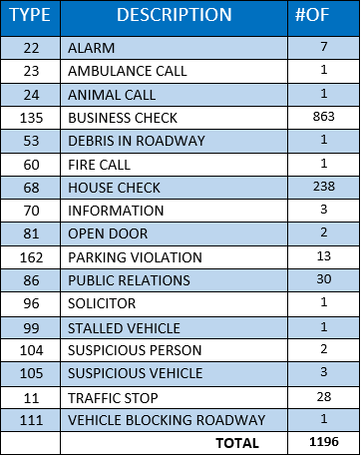
SPRING VALLEY POLICE DEPARTMENT
HILSHIRE VILLAGE
CALLS BY TYPE: 07/01/26 THRU 07/31/26
COMMUNITY MATTERS.
WE ARE A TEAM.
1025 CAMPBELL ROAD, HOUSTON, TX 77055
PHONE: 713-465-8323 / EMAIL: DISPATCH@SPRINGVALLEYTX.COM

Slide 8
IMPORTANT NUMBERS AT A GLANCE
EMERGENCY |  | NON - EMERGENCY
911 - FOR ALL EMERGENCY |  | 713-465-8323
988 – NATIONAL SUICIDE & MENTAL HEALTH
SPRING VALLEY VILLAGE |  | VILLAGE FIRE DEPARTMENT
SPRING VALLEY - CITY HALL | 713-465-8308 | VILLAGE FIRE DEPARTMENT |  | 713-465-2323
SPRING VALLEY - PD | 713-465-8323 | VFD - NON-EMERGENCY |  | 713-468-7941
SPRING VALLEY - PD FAX | 713-465-3135
SPRING VALLEY - COURT | 713-465-0333
HILSHIRE VILLAGE
HILSHIRE VILLAGE – CITY HALL | 713-973-1779
COMMUNITY MATTERS.
WE ARE A TEAM.
1025 CAMPBELL ROAD, HOUSTON, TX 77055 / PHONE: 713-465-8323 / EMAIL: DISPATCH@SPRINGVALLEYTX.COM

